Slide 1
COMPANY PROFILE
COMPANY PROFILE
ELECTROTRADERS
Date

Slide 2
COMPANY BACKGROUND
Electrotraders started its business of supplying industrial automation control parts in 1986 in Faisalabad. With the passage of time, the company extended its supply network to other parts of the country like Lahore, Karachi, and Rawalpindi/Islamabad etc. Initially the company used to purchase the parts from local market but as the company grew, it started importing the parts from renowned world companies. Today by the grace of Allah, the company holds sufficient stock of automation control parts of world’s leading companies.
In 1996, the company under its expansion plan opened a branch office in Lahore (Brandreth Road) to cover Lahore and surrounding areas. In 2000, the company adopted related diversification strategy and set up an engineering department to provide engineering services and manufacture panels for the industries. In 2001, the engineering department started developing the automation with PLC control system and distributed I/O’s control syst
In July 2006, the company opened a branch office in Islamabad, which is taking care of upper Punjab and entire NWFP. The company has opened another branch office in Karachi in Dec 2006 to feed the southern zone of Pakistan.

Slide 3
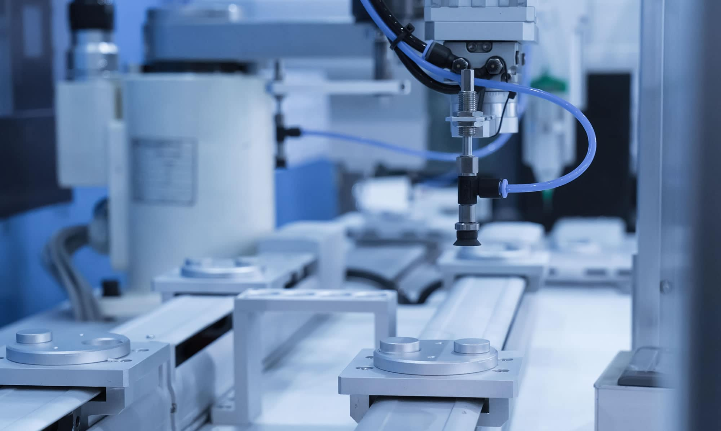
COMPANY OVERVIEW
Electrotraders is the premier supplier and service provider of automation parts and services in Pakistan. The company founded in 1986 has in a span of 30 years served every industry in Pakistan with our range of high-quality products. Through genuine and exclusive products, the company has engendered high customer loyalty, satisfaction and brand recognition. Combined with our on ground technical team made up of talented and studious engineers’ company has provided high quality on ground sales and services to our customers for decades that are parallel to none.
The company has spent more than two decades, in developing a strong connection with its customers, and clients. With hundreds of satisfied customers in the industry all over Pakistan Electrotraders boasts a long list of satisfied clients. The company is an authorized distributor for Siemens Pakistan, it is one of only few authorized distributors and the oldest one too. With other partners such as Omron, Schneider and ABB the company has a consortium of products that spans from the basic necessities of the industry to the once in a life time upgrades.
The company has varied business interests, including direct selling to the industry which is our core business. We also provide Automation related services, and turn key automation solutions to our industry partners along with Automation and PLC training to out valued clients.

Slide 4
WE PROVIDE
Authorized Distribution of Products from Siemens, ABB, Schneider and Omron
LV components PLC components Drives and Motors
Automation Services
Automation Training

Slide 5
AUTOMATION
The company has been providing automation services, for over two decades. With hundreds of satisfied clients under its belt the company has become one of the leading automation service providers in Pakistan. Being an importer and distributor of electronic products, the company has a sleek advantage over the competition that is pretty evident in the quality of our work as well as our satisfied client who have called us back for every project since they started working with us, and this is a record we are proud of.
We provide innovative technological production systems. We provide innovate technological solutions to a wide range of customers in the fields of manufacturing and industrial processes with the help of our team of qualified experts in mechanics, electricity, automation, robotics, instrumentation and information systems.
Our talented employees focus their energy on helping businesses meet the challenges of today's new economic realities, such as globalization, competitiveness and ever-changing commodity and energy prices.

Slide 6
WHAT SETS US APART?
We are firmly believers in customers involvement in the project and we encourage you to bring to the table your knowledge of their environment to the table. Clients are the specialist when it comes to their products and their market. Clients excel in your field, and we excel in ours: the field of automation.
We are highly experienced in the industry, and the sole goal of our experience staff is to identify challenges in order to offer clients innovative solutions that will yield substantial saving and improve their productivity.
We have what it takes to increase your efficiency by optimizing a strategic production unit within your companies or by designing an overall plan to improve productivity.
Our extensive experience with systems puts us in an ideal position to help clients achieve the industrial efficiency they are seeking, minimizing costs while respecting the quality of products.
By working closely with clients’ existing staff, we are able to implement solutions to meet specific needs and make a positive impact on production and quality.
Logo here

Slide 7
OUR STRENGHTS
Computer programming
Software development and testing
Troubleshooting equipment problems
Complex system testing
Creativity and detail oriented
Excellent manual dexterity
Strong communication skills
Logo here

Slide 8
SERVICES WE PROVIDE
Our engineering solutions include,
Troubleshooting
Modification
Up gradation
Firmware up gradation (redundant systems)
Installation
For,
Siemens PLC programming
Siemens HMI
Siemens SCADA (WINcc)
Siemens PCS7 system
Logo here

Slide 9
INDUSTRIES WE SERVE

Slide 10
Food & Beverage
Advanced food and beverage manufacturing systems are the cornerstone of every Food & Beverage industry. We offer comprehensive expertise in the automation of F&B key manufacturing process such as Distillation, Pasteurization, Sterilization etc. The company has worked with Food and Beverage giants in Pakistan.

Slide 11
Chemical
Shorter product life cycle, downtimes, high customer demand and low profitability are major challenges to chemical industries. We understand these problems and thus offer best integrated & scalable automation solution to chemical industry processes. Such as Continuous Processes, Batch Processes and Auxiliary Plants

Slide 12
CEMENT
Sustainable cement production solution is our goal. Cost-efficient production and a simultaneous emissions reduction can only be achieved using components that are perfectly adapted to one another. We have all of the necessary skills and a perfectly matching portfolio to meet all your cement production requirements.

Slide 13
Paper and Pulp
We have a strong technical background of system integration in paper and pulp industries. We provide precise and prefect automation solutions to paper industry. Our sophisticated real time PLC control and efficient HMI designs maintain critical processes so that user can produce and analyze with maximum ease.

Slide 14
FILLING AND PACKAGING
Filling & packing lines system integration are critical to a successful manufacturing process. Our Services for filling & packing industries include:
PLC and HMI/SCADA software development.
Automation consulting services, including platform upgrades, production rate monitoring and analysis, process optimization and many other topics.

Slide 15
Power & Energy
Power & Energy sector has to improve environmental performance, keep consumers’ costs down, and at the same time maintain system reliability. Our automation solution help maintain the needs of P&E industry. i.e.
Fully optimized SCADA designs to effectively control and monitor.
Fully integrated PLC/DCS automation for better reliability.
Electrical Design and fabrication of control panels.

Slide 16
THANK YOU!
Abdullah Nasir
0321833363
Abdullahnasir@Electrotraders.com
Electrotraders.com.pk

